Slide 1
Software for Social Good

Slide 2
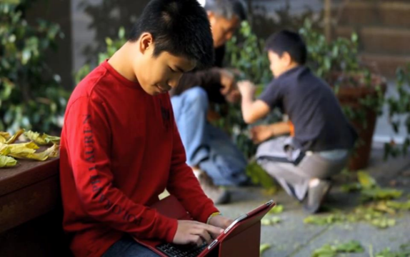
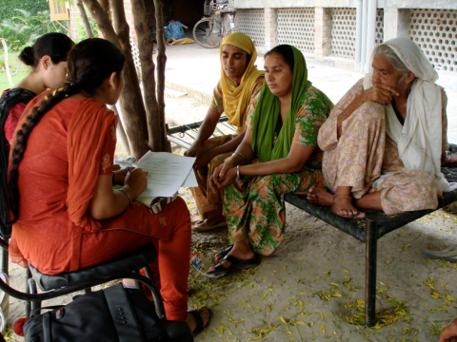
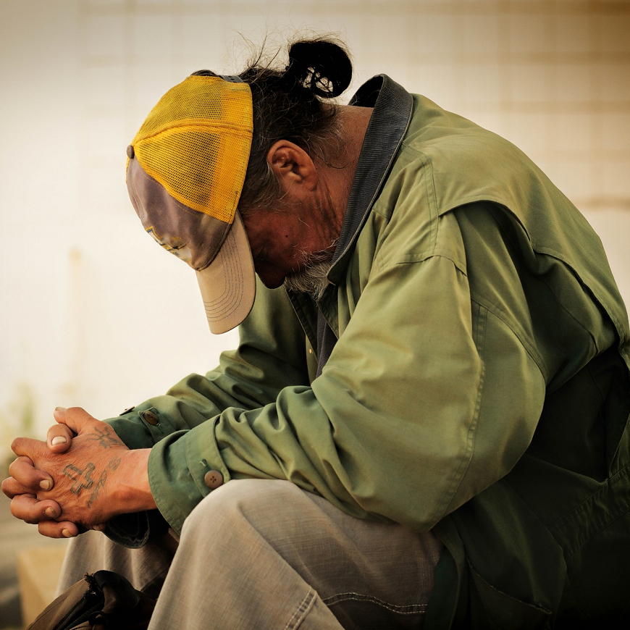
Our work
GLOBAL EDUCATION and LITERACY
HUMAN RIGHTS
We empower communities
with software
for social good
POVERTY ALLEVIATION

Slide 3
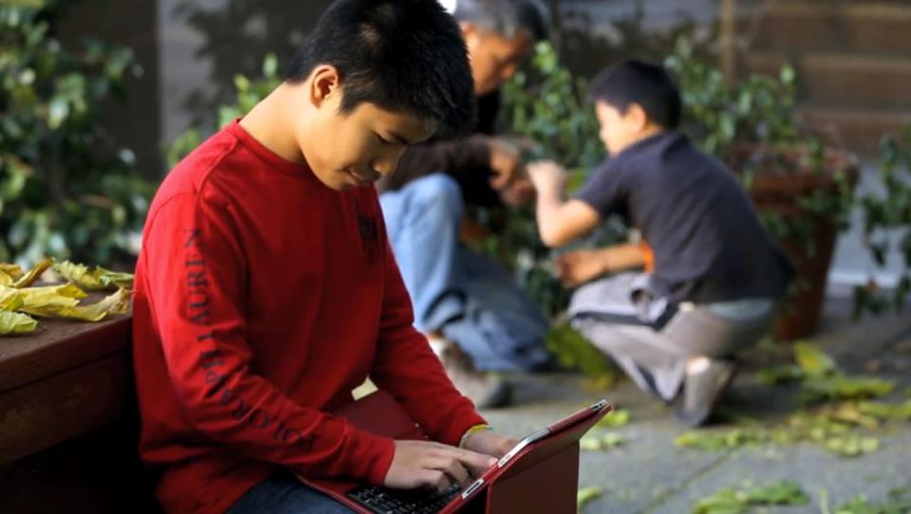
Bridge
We serve as a bridge between the social sector and Silicon Valley to
drive lasting social change

Slide 4
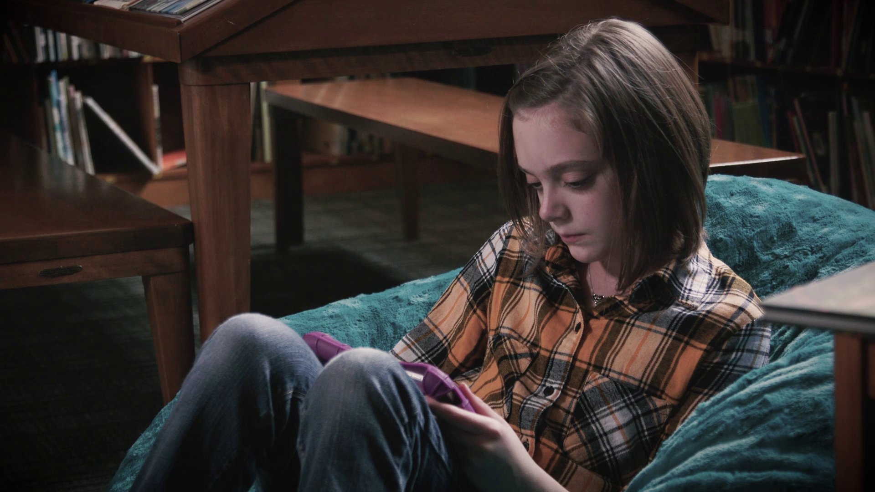

Bookshare Statistics
15 Million+ accessible ebooks delivered
700,000 Bookshare users
780,000+ Books
870 publisher partners
47 languages

Slide 5
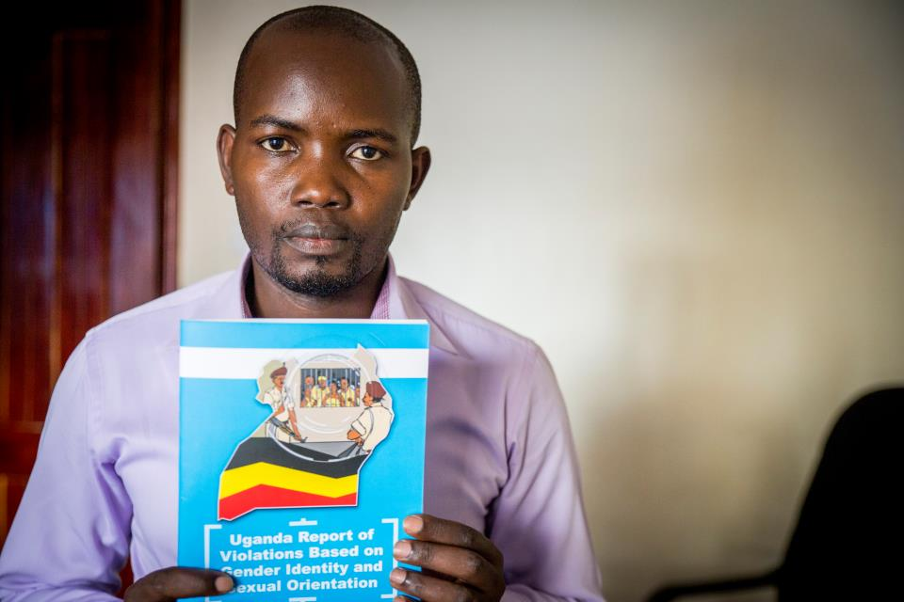
Human Rights
50+ Countries
Thousands of human rights activists securely documented violations

Slide 6
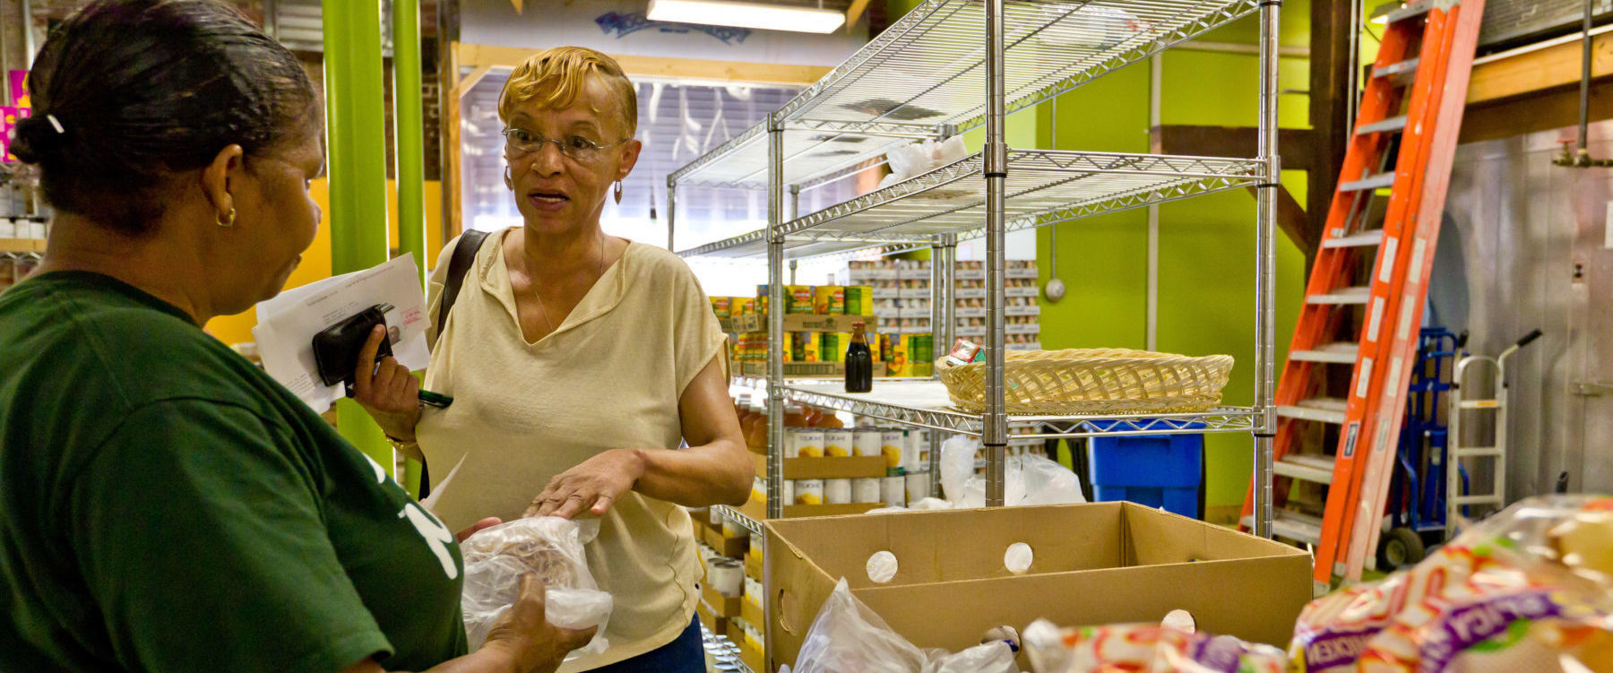
Human Services
1.7 Million
People in the Bay Area with better access to human services*
*Projected

Slide 7
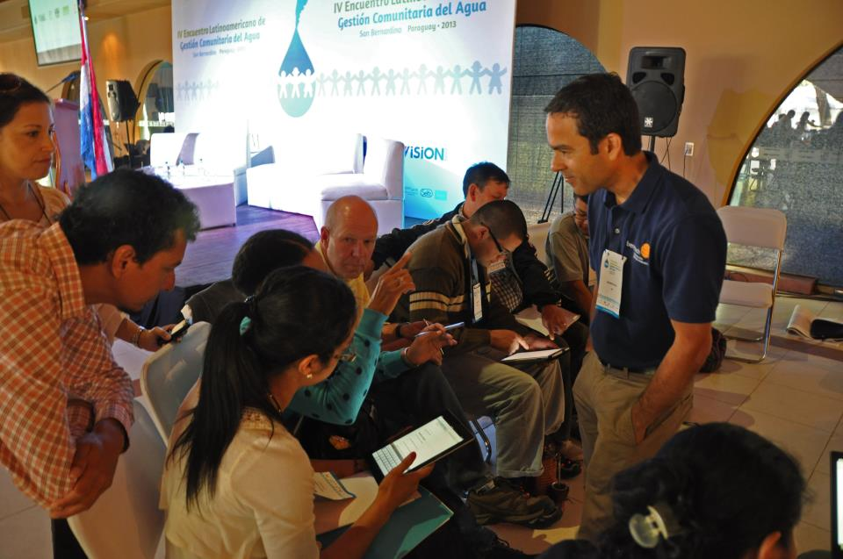
Community Outreach
We advise, build and foster the software for social good ecosystem.

Slide 8

Labs

Slide 9
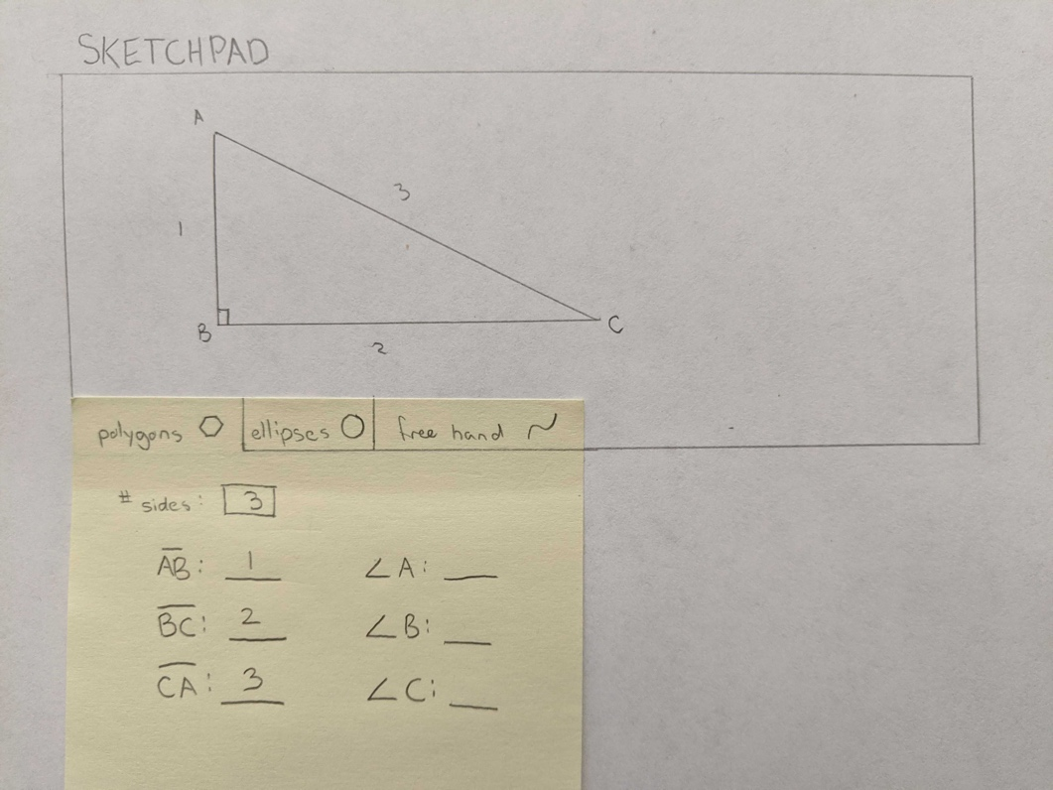
Hackathon IDEA: Accessible Math Sketchpad
GitHub: https://tinyurl.com/ugptajd
Challenge: Create a web-based Accessible Sketchpad that will draw basic geometric shapes based on users input and done in such a way that students can explore the image created in an accessible way!

Slide 10
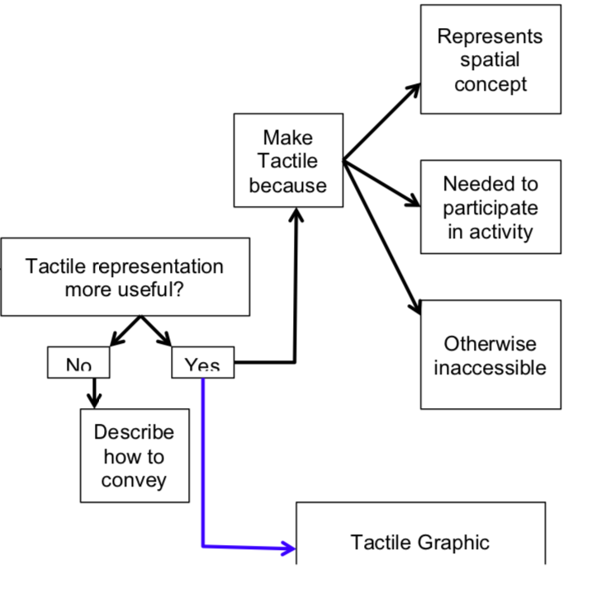
Hackathon IDEA: Accessible Survey Logic
GitHub: https://tinyurl.com/rd6wwbl
Complex surveys that use branching logic based on the answer of a previous question are inaccessible to users that require assistive technology. We need an assessible option!

